Slide 1


CTEC 3451: Project Management
Beverley Hancock-Smith Centre for Learning and Study Support (CLaSS) Enhancing academic practice, writing development and professional skills

Slide 2

In this session we will look at...
Your concerns over managing your final year project
Time management
Procrastination
Project management tools

Slide 3
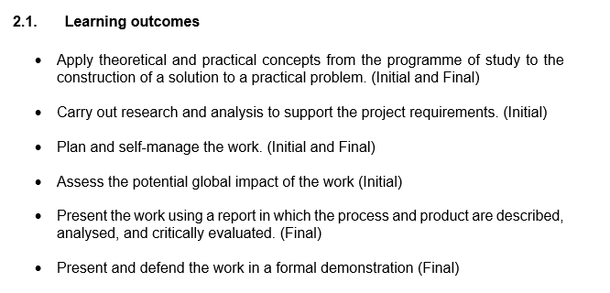
Final Year Project
The project provides students with the opportunity to carry out a significant piece of work involving critical analysis and reflection to provide an effective solution to a given technical and/or research-based problem.

Slide 4
You and Organisation
How do you organise tasks and projects now?
What could you do better or try out in the future?
3 minutes
End

Slide 5
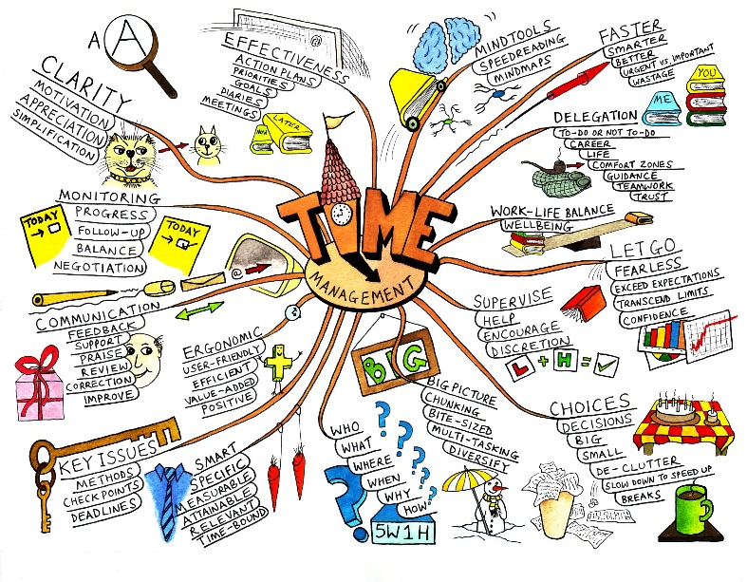
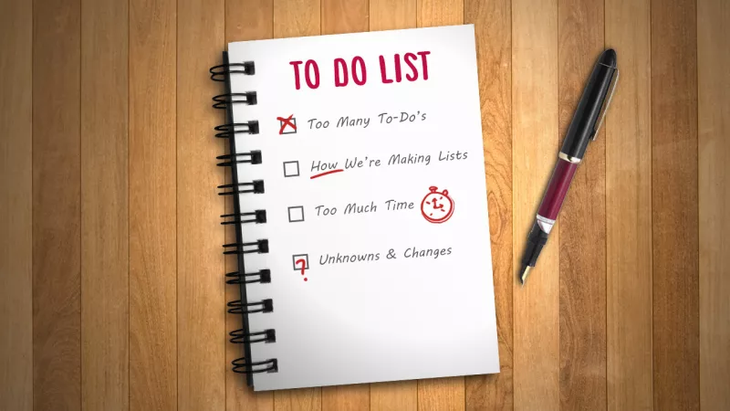
Task
List/mind map all of your objectives and tasks – large and small
This includes things outside of your studies too!

Slide 6
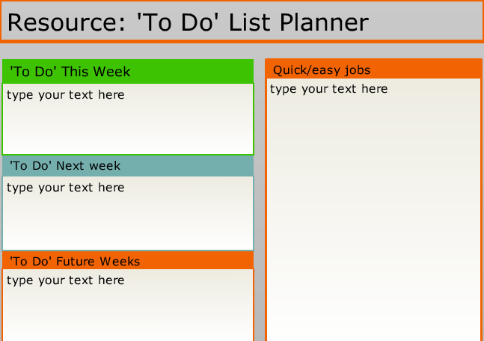
Next… organise your tasks

Slide 7
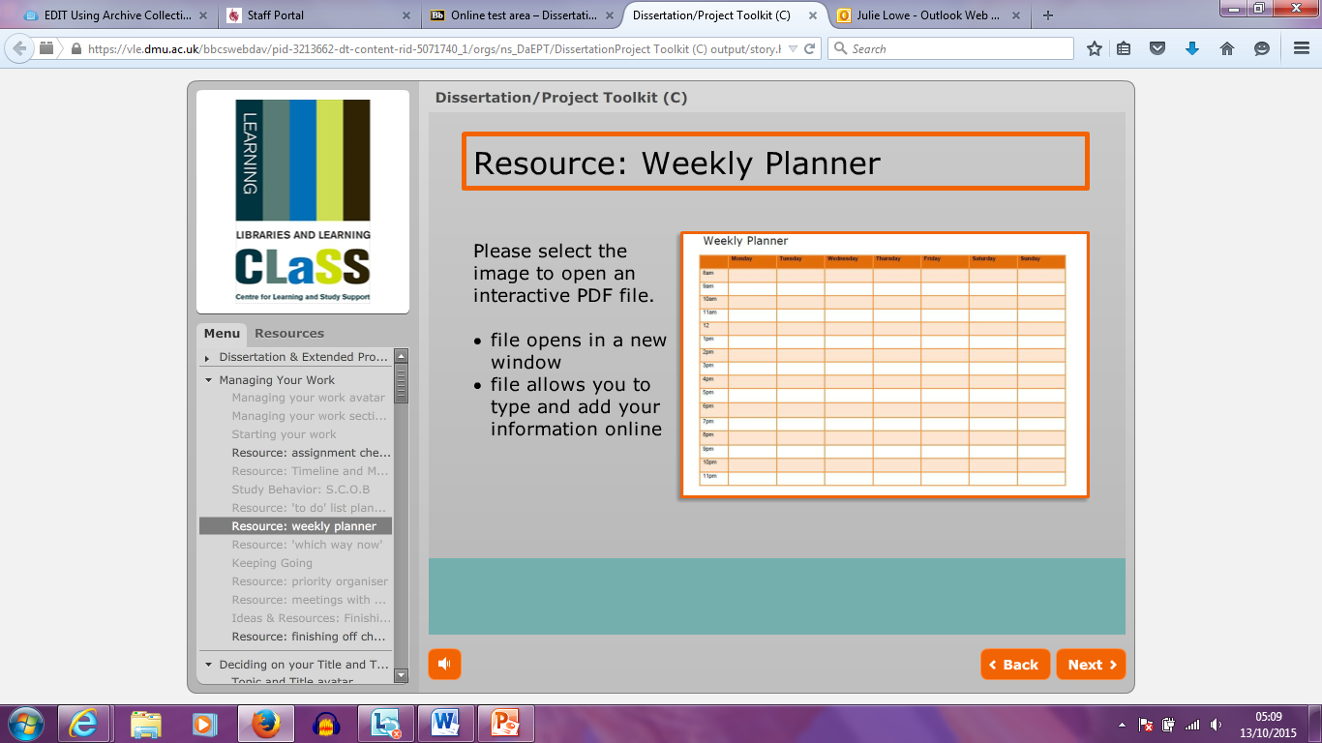
Then… create a project plan:
Place on a timeline
Work backwards from the deadline
Adapt as things change!
Use planning tools: CLaSS Dissertation Toolkit
Notes:
Does anyone use any tools successfully?

Slide 8
Setting SMART objectives
Specific | Clear, unambiguous. Describes what is to be done. Use action verbs – read, write, improve, review, create, plan, use
Measurable | How will you know when you have succeeded? How will you measure success? Quantify if possible – respond in x days, increase by x%
Achievable | A reality check! Some challenge/stretch but realistic, given available resources (time, skills and knowledge). Consider any barriers to achievement.
Relevant | How does it link to your aim? Is it relevant to your role and/or the work you have to do?
Time framed | When will it be done? Start date, milestones, review dates and end date.
Sometimes also SMARTER, where E = Evaluate, R = Re-evaluate, recordable, rewarded

Slide 9
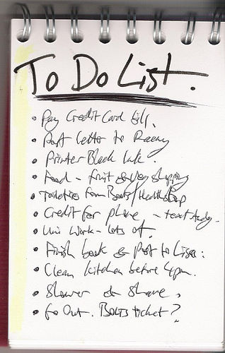
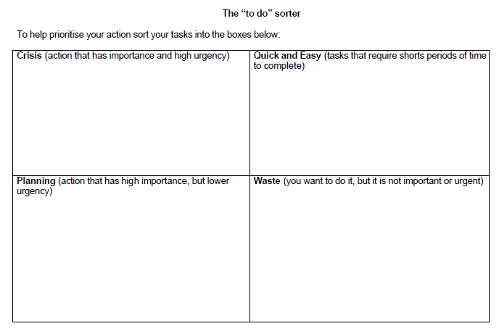
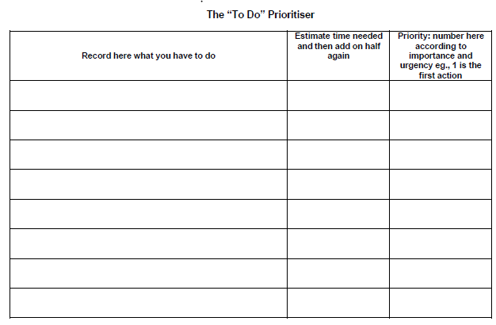
Paper-based tools

Slide 10
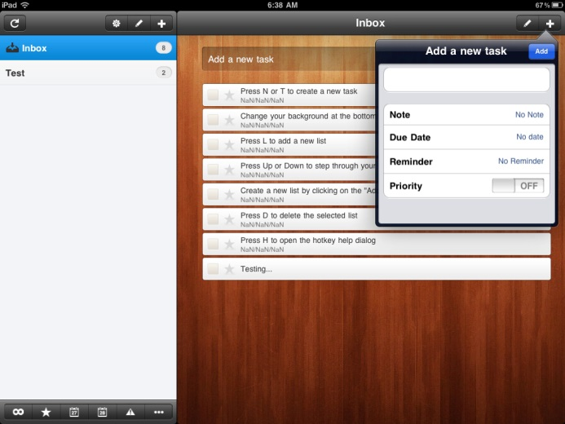
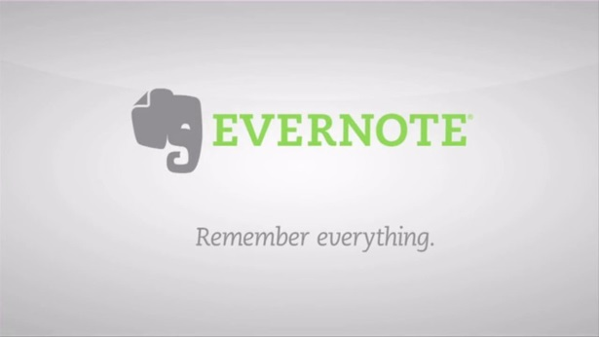


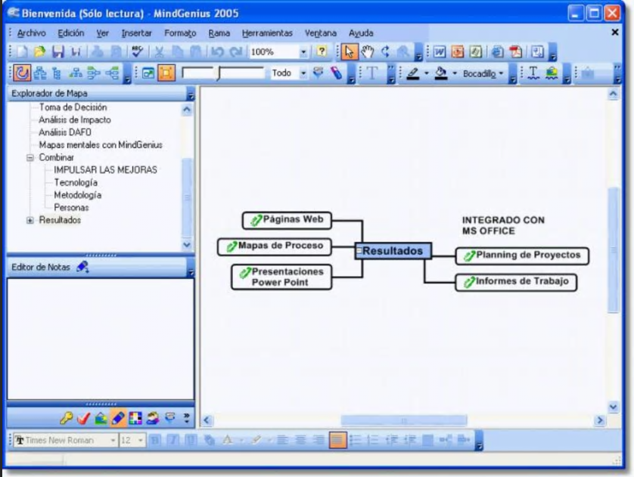

Digital Tools for Organising Your Study
Referencing Ideas/Notes
Backing up

Slide 11

Time management

Slide 12
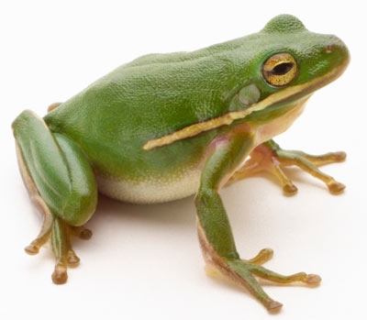
Eat me!
Notes:
If you had to eat a live frog each day, when would you do it?

Slide 13
“Mark Twain once said that if the first thing you do each morning is to eat a live frog, you can go through the day with the satisfaction of knowing that that is probably the worse things that is going to happen to you all day long.
Your “frog” is your biggest, most important task, the one you are most likely to procrastinate on if you don’t do something about it.”
TRACY, B. (2001). Eat That Frog: Brian Tracy Explains The Truth About Frogs. [online] Available at: https://www.briantracy.com/blog/time-management/the-truth-about-frogs/ (accessed 19.10.18)

Slide 14
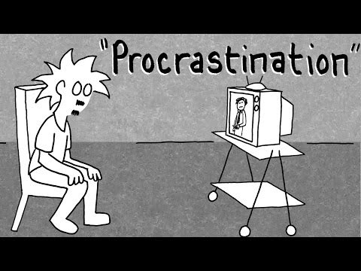

Slide 15
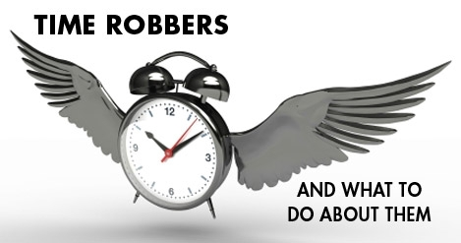
What are your “time thieves”?
Planning | Not setting goals, No daily plan, Priorities unclear or changing, Leaving tasks unfinished, Fire fighting/crisis management, No self imposed deadlines, Attempting too much
Organising | Personal disorganisation, Duplication of effort, Confused responsibility, Multiple demands
Directing | Ineffective delegation, Involved in routine details, Lack of motivation
Controlling | Telephone interruptions, Drop in visitors, Lack of self discipline, Too many interests, Inability to say no
Communication | Failure to listen, Socialising, Over use of social media
Decision making | Snap decisions, Indecision/procrastination, Wanting all the facts, Perfectionism
Home time | Poor planning, Poor planning in meals, Not planning meals ahead, Doing jobs for others, Family appointments

Slide 16
Time Thieves
Use a blank sheet of paper and list up to 3 of your personal time thieves
Discuss with a neighbour, and each write down ideas on how you will combat your thieves.
3 minutes
End
Notes:
Chose one strategy and share it with the rest of us – make a public commitment!

Slide 17
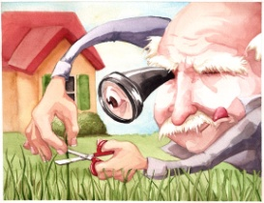
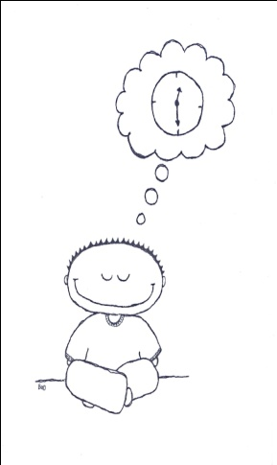
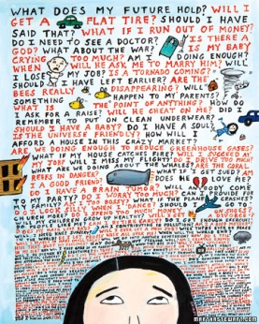

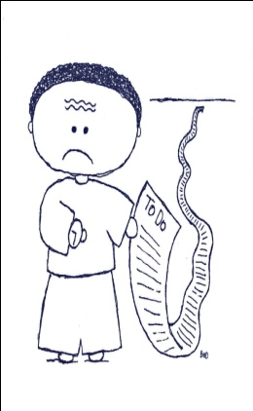
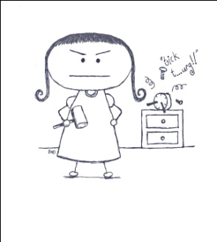
Procrastination: What kind of procrastinator are you?
Perfectionists fear that they can’t finish a task that will measure up to their high standards
Dreamers have big goals that they seldom translate into specific plans
Worriers avoid change and risk taking, and talk about problems not solutions
Crisis makers create excitement by waiting until the last minute
Defiers resist new tasks or promise to do them and don’t follow through
Over-doers create work for themselves by taking too much on and not delegating
From: “It’s About Time!: The Six Styles of Procrastination and How Students Can Overcome Them”, Linda Sapadin (1997)
Notes:
Show of hands for which statement you most identify with.

Slide 18
Ideas to combat procrastination
Type of Procrastinator | Ideas
The Perfectionist | Set realistic (not idealistic) goals. Set time limits for each task.
The Dreamer | Try turning some of your dreams into concrete goals with a timeline and a deadline. Spend time on them regularly
The Worrier | Answer your “what ifs” with a plan. Break bigger projects into pieces
The Crisis-Maker | You’re not a victim; see tasks as opportunities. Reward yourself for getting started earlier.
The Defier | Take responsibility for your choices. Remember the relationship between short and long-term choices
The Overdoer | Remember that no one has it all; you have to prioritise and decide what to care about. Learn to say “no”.
From: “It’s About Time!: The Six Styles of Procrastination and How Students Can Overcome Them”, Linda Sapadin (1997)

Slide 19
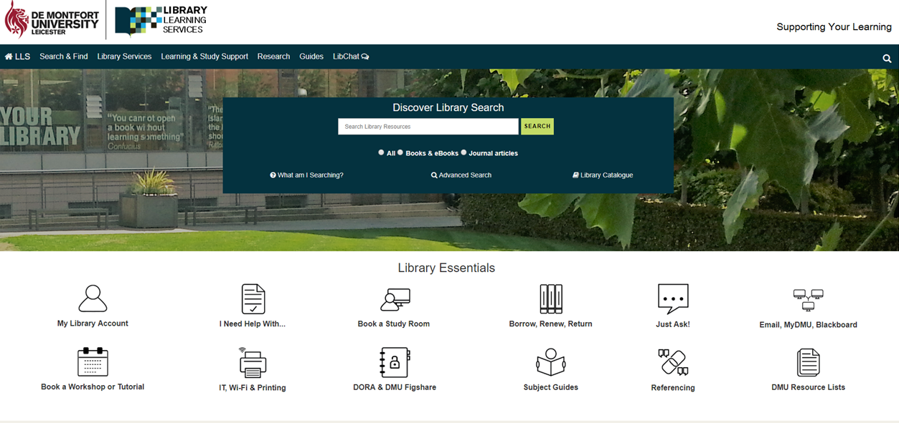
Support Library Website
www.library.dmu.ac.uk

Slide 20
Questions ?

